Slide 1



Annual Interagency Accessibility Forum
Achieving Digital Equity: Policies, Tools, and Techniques
November 13-14, 2024
GSA Section 508 Activities Update
GSA Government-wide IT Accessibility Division
Andrew Nielson, Michael Horton, Laura Miller, Kristen Smith-O’Connor, Alex Wilson

Slide 2




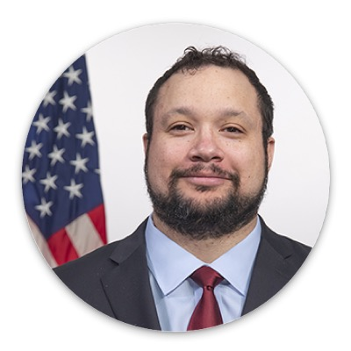
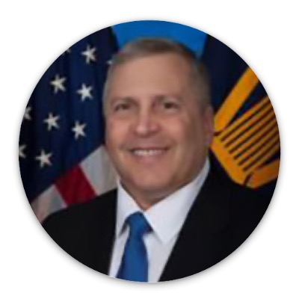
Introductions
Andrew Nielson
Director, IT Accessibility Division
Michael Horton
Sr. ICT Accessibility Specialist
Laura Miller
Sr. ICT Accessibility Specialist
Kristen Smith-O’Connor
Sr. ICT Accessibility Specialist
Alex Wilson
Program Analyst
Merrick Krause
Enterprise Programs Executive, GSA
Notes:
Agenda (50 min speaking, 10 min for ?s; Laura presenting slides)
(Drew) Intro + FY24 Highlights (5 min)
(Mike) Section 508 Resources (10 min)
(Alex) M-24-08 Resources (10 min)
(Kristen) Assessment & (Slide 1) FY25 Look Ahead (10 min)
(Laura) (Slide 2) FY25 Look Ahead & Key Dates (3 min)
(Andrew) Tee up Merrick
Merrick Krause – GSA’s Human Capital successes (10 min)
Questions (10 min)
10 min for Agenda (50 min speaking, 10 min for ?s)

Slide 3

FY24 Highlights
Delivered the FY23 Annual Assessment and soon to release the FY24 Assessment
ICT Testing Baselines
Updated the ICT Baseline for Web
Released the Electronic Documents Baseline
Published Multiple Content Updates on Section508.gov
Produced Accessibility Bytes; Improved Digital Accessibility Newsletter
Developed a Section 508 PM Certification initial feasibility analysis
Published ACR Editor under Section508.gov
Notes:
TONE: time spent on their behalf - doing things, fixing things, developing tools and resources for the community;

Slide 4

Section 508.gov Resources (1 of 2)
Our team constantly reevaluates user needs and opportunities to improve guidance and skill building available from Section508.gov. Let's look at some of the highlights…
Guidance supporting Office of Management and Budget M-24-08 & M-23-22
Designing Digital Content For Users With Cognitive Disabilities
Establishing and Maintaining a Formal Complaint Process
Implementing a Public Feedback Mechanism
Roles and Responsibilities
Tips for Usability Testing with People with Disabilities (OPM)
Developing a Web Accessibility Statement
Accessibility Policy Framework
Notes:
Plug for feedback or new needs

Slide 5
Section 508.gov Resources, (2 of 2)
Content Development
Accessible Social Media (USAB)
Accessible Meetings
Authoring Meaningful Alternative Text
Captions and Transcripts
Checklist for Accessible Email Messages (FHWA)
Common PDF Tags and Their Usage (ED)
Online Training Courses
Accessibility of ICT for Government Executives
Micro-Purchases and Section 508 Requirements* - Refresh in FY25
Microsoft Word & Accessibility Best Practices
Procuring Section 508 Conformant ICT Products and Services*
Section 508: What Is It and Why Is It Important?*
Soliciting and Evaluating Accessibility Conformance Reports in Federal ICT Procurement
*COs & CORs!
Earn Continuous Learning Points (CLP) by completing these courses on FAI.gov
Notes:
Mike - distinction between OMB efforts and the certificate courses

Slide 6
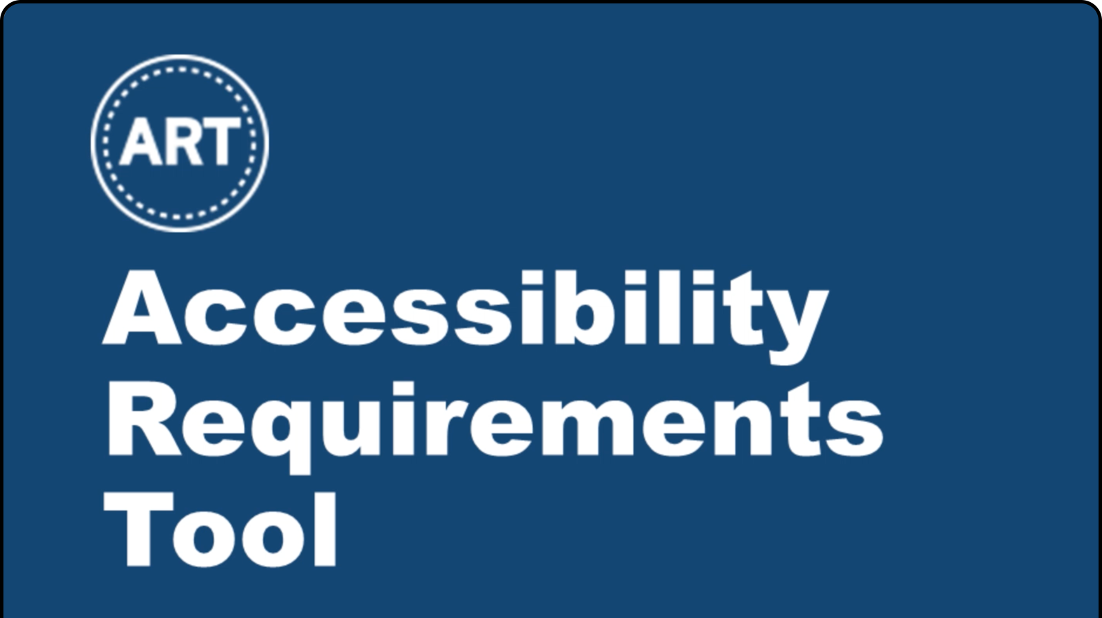


M-24-08 Implementation & Resources, Tools (1 of 2)
The Governmentwide IT Accessibility Team has been diligent in creating solutions in response to M-24-08: Strengthening Digital Accessibility
Tools
Acquisition-related Tools: ART, SRT, OpenACR Suite - ACR Editor and ACR Repo (FY25)
Developed Section 508 PM Certification initial feasibility analysis
Centered on defining options for a way forward to create standardized training, qualifications and knowledge with respect to Section 508 PMs across government
Notes:
M2408 Agency Policy & Guidance - promoting things that are already out there - policy framework, trainings
In response to M-24-08 - initial feasibility analysis and provided a report to OMB, looking for additional funding and analysis

Slide 7
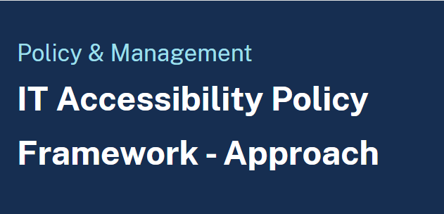
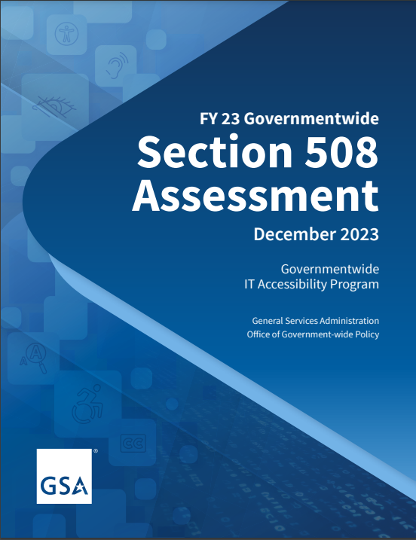
M-24-08 Implementation & Resources, Tools (2 of 2)
Guidance derived or related to the Memo
Agency Actions: Section PM listing, updated website accessibility statement, public feedback mechanism, complaints
Content: Usability Testing with Persons with Disabilities
Policy Review: Accessibility Policy Framework
Annual Assessment (Year 2)
Notes:
M2408 Agency Policy & Guidance - promoting things that are already out there - policy framework, trainings

Slide 8

FY24 Annual Governmentwide Section 508 Assessment
Data shows an increase in the number of entities that have a Section 508 Program Manager.
Overall, maturity has slightly improved governmentwide in FY24 and remains Moderate. Conformance of ICT did not improve and remains low governmentwide.
Of the top viewed ICT, we see stagnation in accessibility efforts, with the majority of entities showing no movement year over year.
Entities have noted, and it is reflected in data, that resourcing has improved, with a small increase in full time equivalents in FY24.
Entities increased the average hours per week a Section 508 PM spent supporting Section 508 efforts.
FY24 Report coming December 2024

Slide 9

FY25 Look Ahead (1 of 2)
FY25 Annual Assessment and new reporting tool development
M-24-08 Actions
Exploration of an Accessibility Design and Testing Lab
Establishing a government-wide service to help agencies acquire products and services related to the accessibility of ICT
Expand ICT Testing Baseline Portfolio
Software
Hardware
Notes:
As Kristen mentioned, stay tuned for the FY2024 annual assessment report To be released in Late December. It will be posted online similar to last year, along with all response data.
Anticipate a similar timeframe for FY25 criteria release (April/May timeframe), with a similar reporting period, office hours, and submission period.
As we receive feedback, we are taking it all into consideration regarding modifications to Assessment questions. Anticipate some edits to criteria but by and large we anticipate the criteria stays the same. Like this year, there will be a crosswalk and specificity on what changed.
We anticipate a new submission tool to be rolled out next year; specific timelines and details TBD but we heard the feedback and are working towards a more user friendly tool all around.
In a continuation of 2024, the team will continue in their efforts under OMB Memo 24-08 to determine the feasibility and financial requirements of an accessibility design and testing lab.
We are also in early stages of research into the acquisition of accessibility tools through blanket purchase agreements.
With the aforementioned release of the Web ICT baseline and the baseline for Electronic Docs, the team is now able to direct their attentions to the Software baseline and the baseline for hardware. Both new baselines will be released by the 3rd quarter of 2025.
Technology Accessibility Playbook - we will update plays with helpful tools, artifacts and templates based on gaps identified from the assessment and feedback from you and other stakeholders.
We are working on posting and revising Accessibility KPIs to provide more assistance to 508 PMs in tracking accessibility maturity and progress.
Efforts to develop, deploy, and populate an ACR Repository will be ramped up in 2025 with a goal to pilot the program to launch in 2025 - please reach out if you are interested in participating in the pilot. IAAF, though happening digitally now, will be held live and in person (with an online option) in May 2025.

Slide 10

FY25 Look Ahead (2 of 2)
ACR Repository - Develop, deploy and populate with product accessibility reports
Technology Accessibility Playbook Enhancements (additional resources and artifacts)
Release and Refine Key Performance Indicators to assist Section 508 PMs
Role-based training for key stakeholders, subject matter experts, and content creators
Improved guidance and training available from Section508.gov
Returning to in-person/hybrid Interagency Accessibility Forum (IAAF) May 20-22, 2025

Slide 11

FY25 Key Dates
Accessibility Bytes - monthly
Digital Accessibility Newsletter - every other month (December, February, April…)
IT Accessibility Community Meetings - 1st Tuesday of every other month (February, April, June…)
Annual Governmentwide Section 508 Assessment
Revised Assessment criteria - Spring
Responses from reporting entities- Summer
Report Release- December
Interagency Accessibility Forum (IAAF) May 20-22, 2025
July 26, 2025: Celebrating 35 Years of the Americans with Disabilities Act (ADA)

Slide 12
Remarks from
Merrick Krause,
Enterprise Programs Executive, GSA
Notes:
Andrew tee up Merrick
Share some of GSA's Human Capital successes - e.g., ASL contracting program, required annual Section 508 training, and others.

Slide 13
Questions?

Slide 14
Thank you!
Visit our Contact Us page at section508.gov/contact-us/
Contact us via email at section.508@gsa.gov

